Slide 1
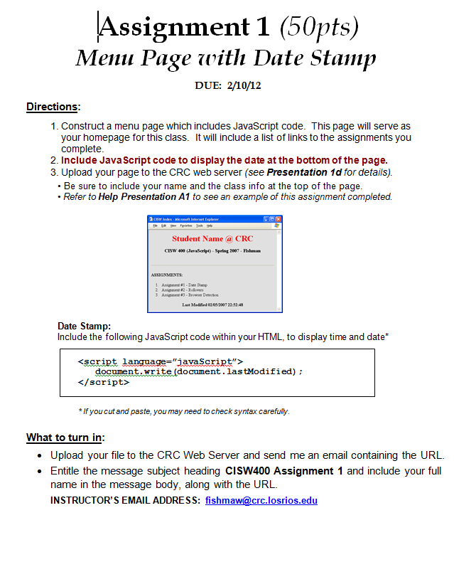
CISW 400 (Online) – Client-side Scripting for the Internet
PRESENTATION A1:
Assignment 1
Help
Tips, Hints,
& Examples
Cosumnes River College
Fishman – 2020

Slide 2
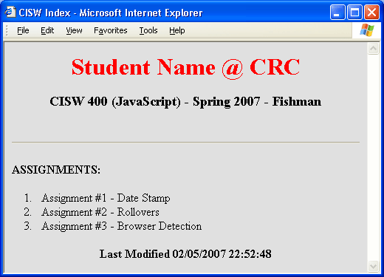
Assignment 1
Menu Page
with Date Stamp
For this assignment, make a menu web page which includes JavaScript code.
This page will serve as your homepage for this class. It will include a list of
links to the assignments you complete. At the bottom of the page insert Java-
Script code for a date stamp.
The purpose of this assignment is to establish your homepage on the CRC server and to familiarize you with basic JavaScript structure.

Slide 3
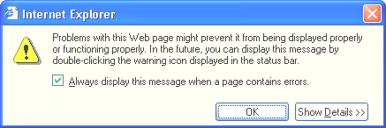
Tips for this Assignment:
Date Stamp
Insert this JavaScript code within the <BODY> section of your HTML:
<script>
document.write(document.lastModified);
</script>
Scripting Errors
Pay close attention to detail when writing code. Exact syntax is important to minimize scripting errors.
Caution: If you cut and paste code, sometimes the quote symbols get changed, causing a scripting error.

Slide 4
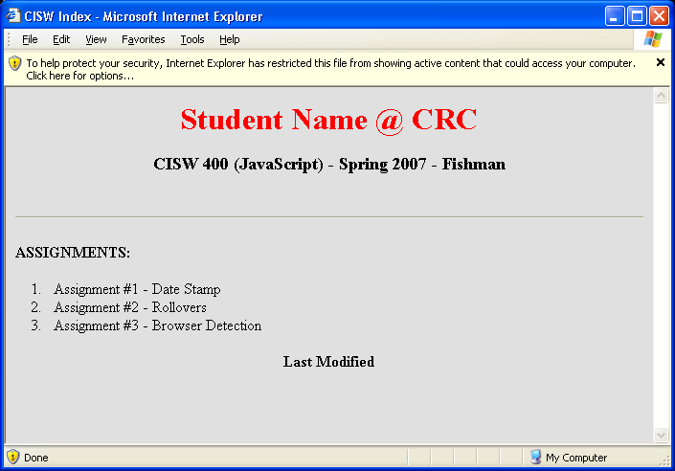

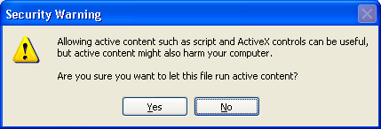
Tips for this Assignment:
MSIE - Security Bar
You may find that when you attempt to open a web page with JavaScript
code, a security alert bar temporarily blocks the page.
To bypass it, click on the yellow bar and select “Allow Blocked Content”. Then click “Yes”.

Slide 5
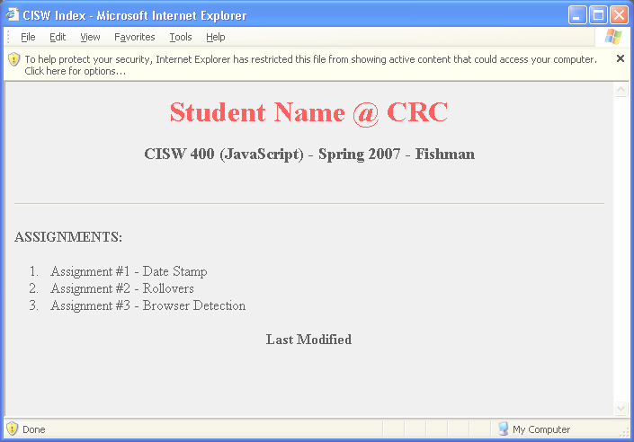
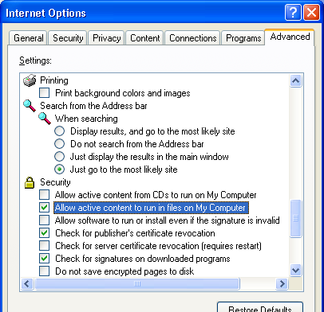
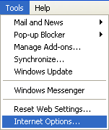
Tips for this Assignment:
MSIE - Security Bar
To disable this security feature, under the Browser Tools menu, go to Internet Options. Under the “Advanced” tab, scroll down to “Security” and check “Allow active content to run in files on My Computer.”

Slide 6
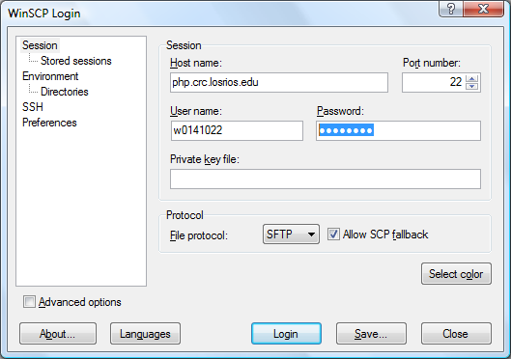
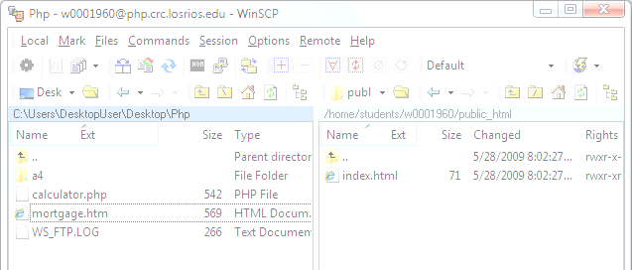
Accessing the Web Server
Server Accounts
Use WinSCP to upload your files to the server CIS Web server
A free download of WinSCP is available at http://winscp.net/eng/download.php
Host Name = cisw2.crc.losrios.edu
cisw2.crc.losrios.edu
User ID = letter “w” followed by student ID
Password* = new2mini
For more server information, refer to Presentation 1d

Slide 7

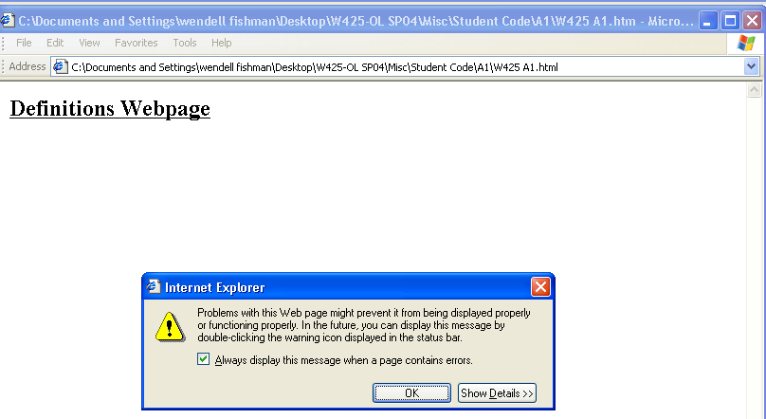
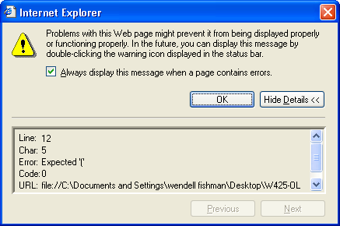
Tips for this Assignment:
Trouble Shooting
If your page is not working, don’t worry, be patient.
They call it Computer Science for a reason. Computer
Programs rarely work right the first time. And thus it is
often necessary to conduct a series of “scientific ex-
periments” in which you isolate parts of your program
and run a series of tests in order to solve the problem.
Pay attention to the error source and line number indicated on the error box.

